Slide 1
Embedded Systems
Final Project:
Temperature Display
Craig Siron, Joseph Saldivar

Slide 2
What it does
Gathers outside temperature
Transmits the temperature
Converts the received data into fahrenheit
Shows a colored display based on the temperature
30-40 Degrees shows purple
70-80 Degrees shows orange

Slide 3
How it works
Our project has two nodes
One that goes outside with the temperature sensor
The other remains inside with the LED
The outside node gathers the temperature as analog data
It then sends this data via Xbee Radio to the inside node
The inside node reads the analog data and finds the information it needs
In this case it is voltage
It then converts this voltage into degrees with a formula based off the sensor
Then, it reads the temperature in degrees and turns on the NeoPixel accordingly

Slide 4
Components
2 Xbee Radios
Xbee Breakout Board
One temperature sensor
One arduino board
One Adafruit NeoPixel LED ring
One solar panel
One capacitor
One rechargeable battery

Slide 5
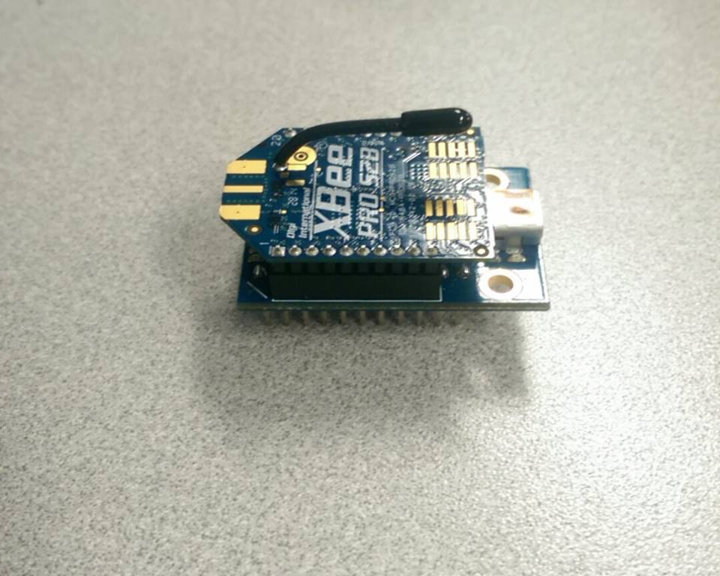
Xbee

Slide 6
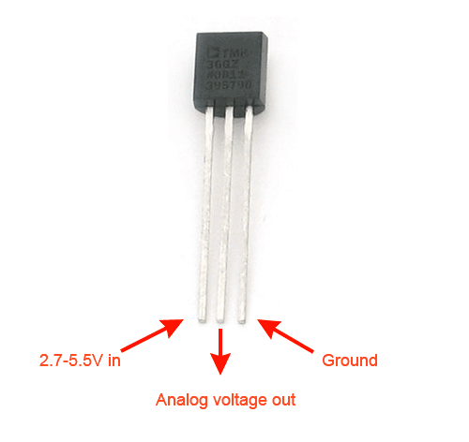
Temperature Sensor

Slide 7
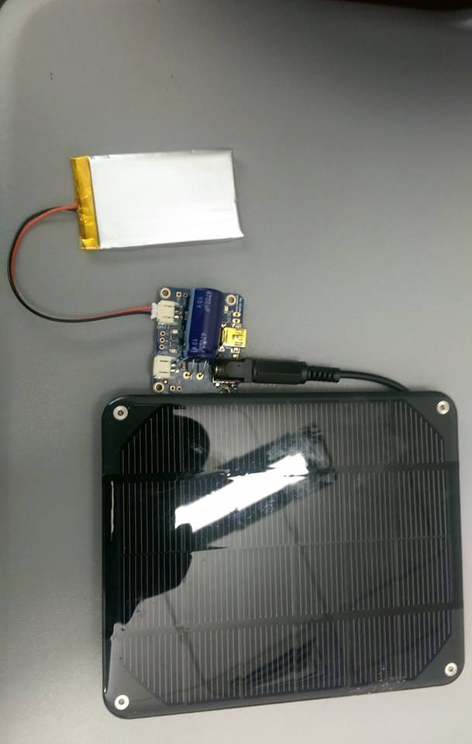
Power Supply

Slide 8
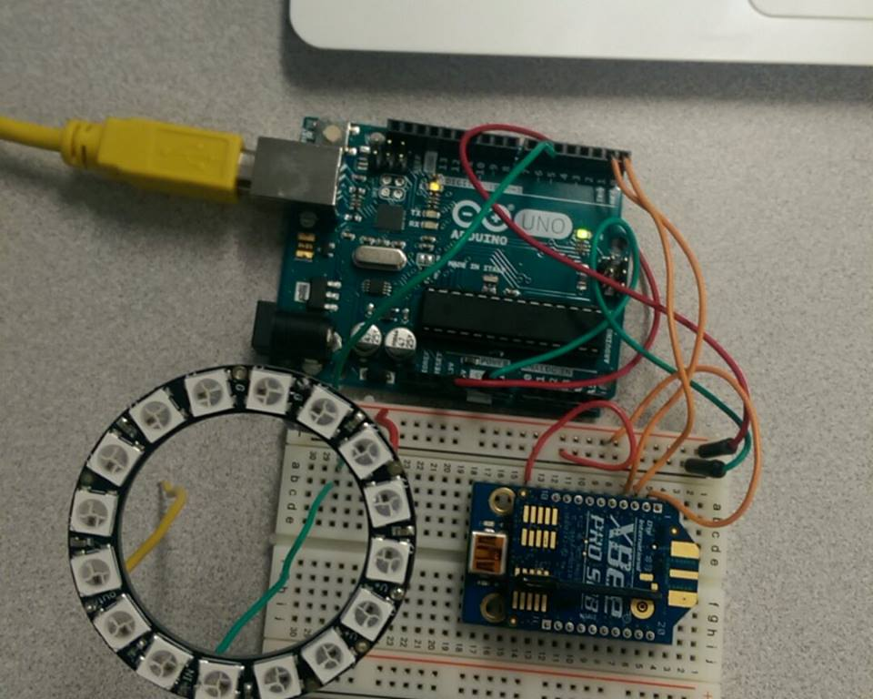
Receiver with Adafruit NeoPixel

Slide 9
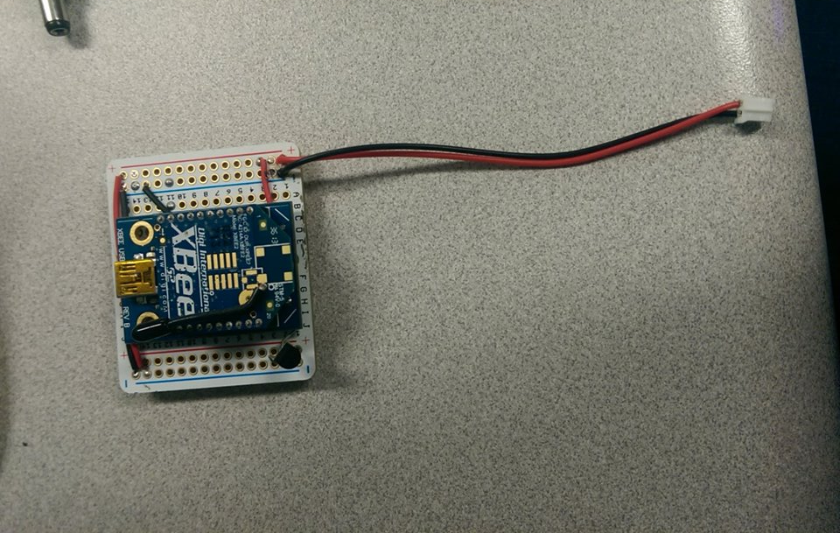
XBee with Temperature Sensor and Breakout Board

Slide 10
Questions?

